Slide 1

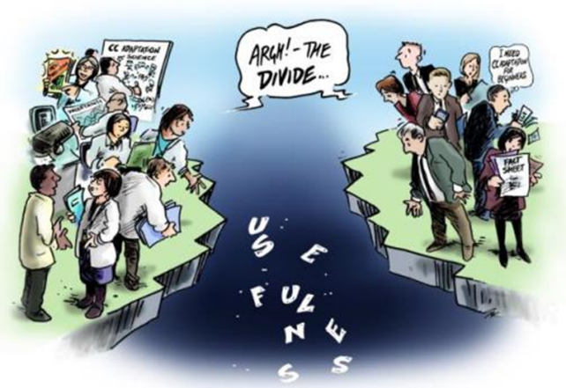

Online Policy Gap Explorer Tool
Web app for exploring, filtering and prioritizing most relevant gaps & needs
Mind the gap…
Illustration: ©Jochen Bürgel; cartoons by Simon Kneebone
Notes:
maladaptive practice of suspending hazard maps and their restrictive effects (ex-post maladaptation)

Slide 2






Online Policy Gap Explorer Tool
Planned functionalities: search mask (filter options)
Policy fields
  Natural Hazard Management
  Civil Protection
  Spatial Planning
  Protection Forest Management
  Forest Fire Management
Gaps locally validated
  Added, concretized, confirmed by pilot areas
  Bottom-up gap only
  No (top-down gap only)
Risk Management Cycle
  Prevention: structural
  Prevention: non-structural
  Preparedness: tools
  Preparedness: tool implementation
  Response: tools
  …
Gap types
  Knowledge, data, evidence
  Awareness & recognition
  Policy Design & Planning
  Governance: organisational & procedural
  Legislative & regulatory
  Resources, capacity & implementation
  Compliance & enforcement
  Effectiveness & efficiency
  Local risk preparedness & community-driven
  adaptive capacities
  Other
Notes:
maladaptive practice of suspending hazard maps and their restrictive effects (ex-post maladaptation)

Slide 3

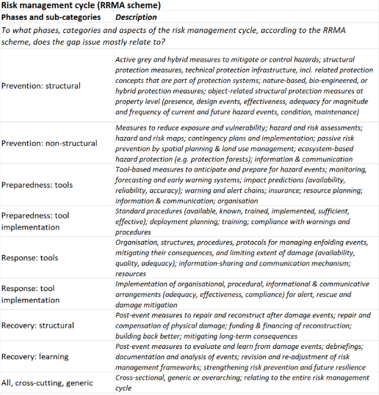
Online Policy Gap Explorer Tool
Planned functionalities: search mask (filter options)
Policy fields
  Natural Hazard Management
  Civil Protection
  Spatial Planning
  Protection Forest Management
  Forest Fire Management
Gaps locally validated
  Added, concretized, confirmed by pilot areas
  Bottom-up gap only
  No (top-down gap only)
Risk Management Cycle
  Prevention: structural
  Prevention: non-structural
  Preparedness: tools
  Preparedness: tool implementation
  Response: tools
  …
Gap types
  Knowledge, data, evidence
  Awareness & recognition
  Policy Design & Planning
  Governance: organisational & procedural
  Legislative & regulatory
  Resources, capacity & implementation
  Compliance & enforcement
  Effectiveness & efficiency
  Local risk preparedness & community-driven
  adaptive capacities
  Other
Notes:
maladaptive practice of suspending hazard maps and their restrictive effects (ex-post maladaptation)

Slide 4

Policy Gap Explorer Tool
Possible search output format
Spatial Planning
Legal coupling of hazard mapping with spatial planning
Strengthening embedding of hazard maps / hazard zone plans in spatial planning laws and building regulations by defining binding and unambiguous legal effects on local spatial planning (consideration requirement): clear and restrictive rules for the zoning of building land and building permits, and requirements for hazard-proof constructions in designated hazard zones.
Risk management cycle: Prevention: non-structural
Gap type: Legislative & regulatory
Locally validated: NO
Previous
Next
2 / 7
Results: 7 policy gaps
Cluster topic
Gap issue gap issue gap issue gap issue gap issue issue gap issue gap issue
Download results (Excel)
Cluster topic
Gap issue gap issue gap issue gap issue gap issue issue gap issue gap issue
Cluster topic
Gap issue gap issue gap issue gap issue gap issue issue gap issue gap issue
Cluster topic
Gap issue gap issue gap issue gap issue gap issue issue gap issue gap issue
Notes:
maladaptive practice of suspending hazard maps and their restrictive effects (ex-post maladaptation)

Slide 5
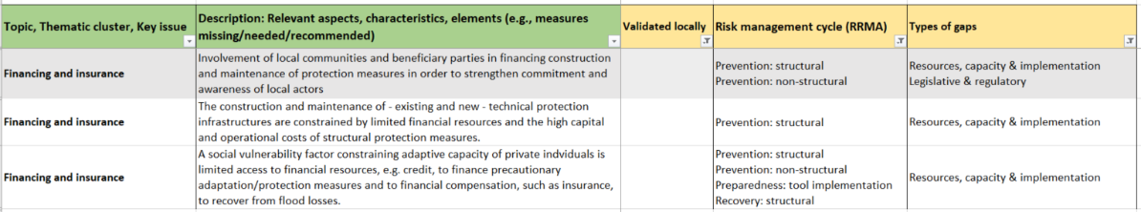
Policy Gap Explorer Tool
Demonstrating the application: manually compiled examples
Policy field: Natural Hazard Management n= 154
Risk Management Cycle: Prevention: structural (contains) n = 30
Locally validated: NO n = 18
Gap types: Resources, capacity & implementation n = 3
Notes:
maladaptive practice of suspending hazard maps and their restrictive effects (ex-post maladaptation)

Slide 6
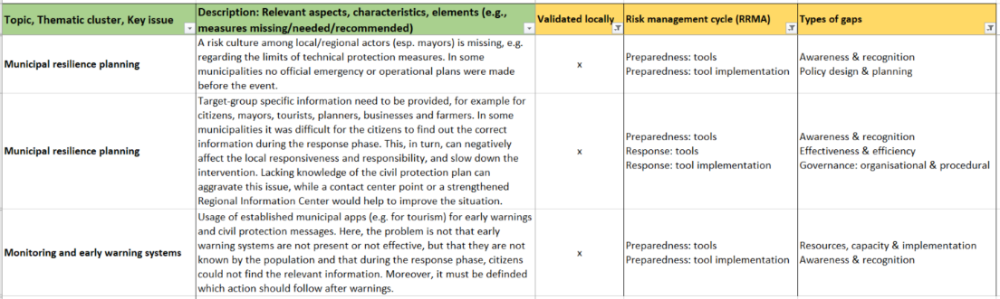
Policy Gap Explorer Tool
Demonstrating the application: manually compiled examples
Policy field: Civil Protection n = 151
Locally validated: Yes – concretized / confirmed OR bottom-up only n = 102
Risk management cycle: Preparedness: tools (contains) n = 44
Gap types: Awareness & recognition (contains) n = 3
Notes:
maladaptive practice of suspending hazard maps and their restrictive effects (ex-post maladaptation)

